Slide 1
International Marketing Analytics–
Course Content and Style
Dr Arne Floh
Senior Lecturer in International Business
arne.floh@wu.ac.at

Slide 2

The Journey begins…

Slide 3
Instructor – Dr Arne Floh
Personal Information
  Senior Lecturer in International Marketing
  Institute for International Business, WU Vienna
  Deputy Program Director Export- und Internationalisierungsmanagement
  WWW:Wirtschaftsuniversität Wien: Arne Floh - Faculty and Staff - Team (wu.ac.at)
  LinkedIn: http://www.linkedin.com/arnefloh
Contact Information
  T: 01 31336 6367
  E: arne.floh@wu.ac.at
  Room D1.5.068
  Office Hours: by appointment
  Please contact me first by email!

Slide 4




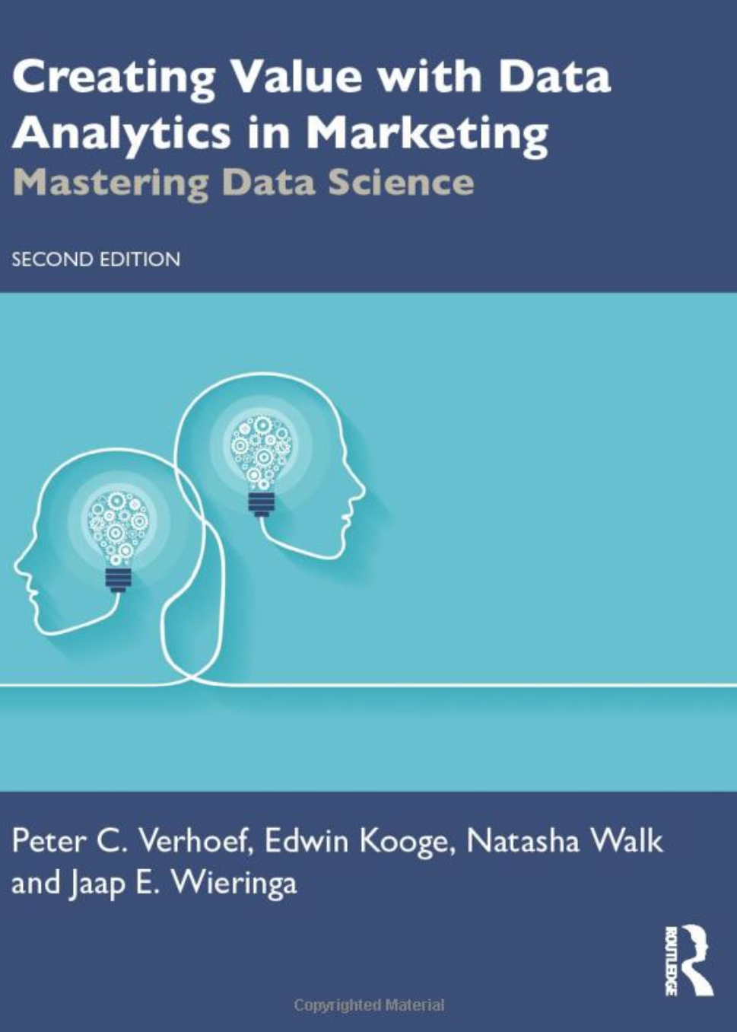
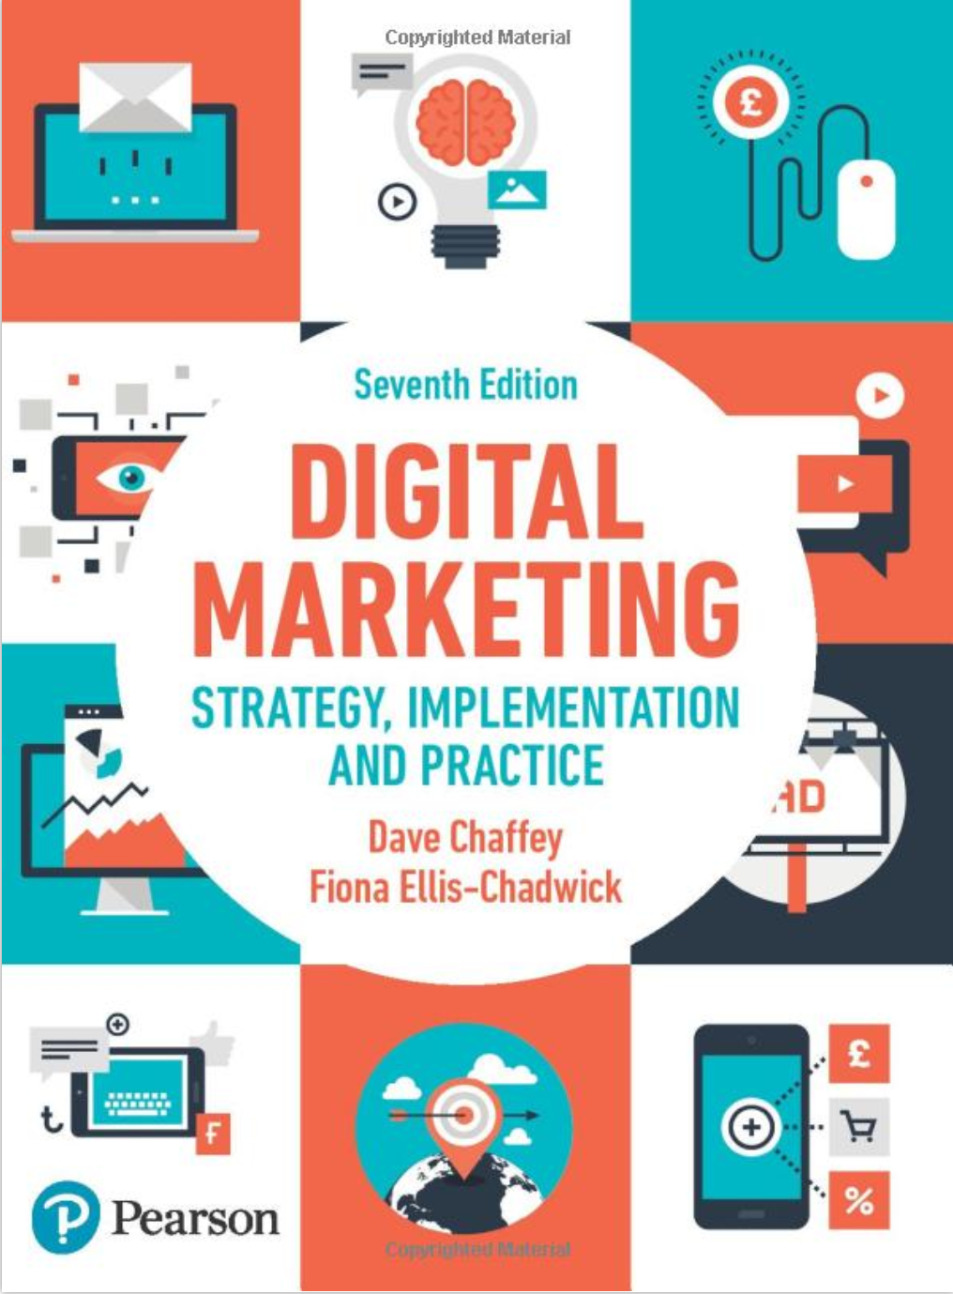

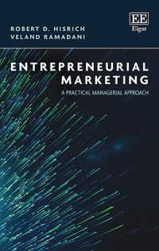





Instructor – Dr Arne Floh
  Work Experience
    International & Industry Background
    Teaching Experience > 20 Years
  Teaching
    Entrepreneurial Marketing
    International Marketing
    Marketing Research and Marketing Analytics
    Digital Marketing & Social Media
    Supervision (BSc, MSc, PhD)
  Research
    Consumer Behaviour, Relationship Marketing
    Electronic Marketing & Social Media
  Private
    Football
    Electronic Gadgets
    Austrian Wine

Slide 5
Module Content
Data-driven marketing decision-making refers to measuring, managing, and analyzing marketing performance data to facilitate market planning, improve marketing effectiveness, and optimize return on investment (ROI).
It encompasses a range of methodologies, technologies, and tools that enable organizations to generate actionable insights from historical and real-time data.
By leveraging marketing analytics, firms can make data-driven decisions to refine their marketing strategies, allocate resources more efficiently, and achieve competitive advantages.
Marketing analytics is an invaluable tool for international businesses, offering many applications that inform and enhance decision-making processes. From market entry strategies to customer engagement, from optimizing the marketing mix to risk management, analytics provides the empirical basis for developing and refining effective international marketing strategies.
Given international markets' complex and dynamic nature, a sophisticated approach to marketing analytics is beneficial and essential for success.

Slide 6
Module Content (continued)
This course covers the core issues companies face when entering international markets and how data-driven decision-making can help resolve these issues.
Typical questions which will be answered in this module include (but are not limited to):
  How can I segment the 'right' customers?
  How can I forecast sales?
  How do I set the price in foreign markets? How can I measure the willingness to pay?
  How can I measure brand value or brand equity in foreign markets?
  How can I develop an effective promotional campaign?

Slide 7
Learning Outcomes
On successful completion of this module, students will be able to:
Understand Marketing Analytics Fundamentals: Gain a foundational understanding of marketing analytics concepts, tools, and methodologies, specifically in an international context.
Comprehend Data Types and Sources: Understand various types of data relevant to international marketing, such as customer data, transactional data, social media metrics
Master Data Import and Export: Learn to import and export data using R from various sources like spreadsheets, databases, and APIs.
Develop Data Cleaning Skills: Acquire skills in data cleaning, transformation, and preparation using R packages like dplyr and tidyr.
Perform Exploratory Data Analysis (EDA): Become proficient in conducting EDA to summarize and visualize data, using packages such as ggplot2.
Conduct Customer Segmentation: Learn to apply clustering algorithms and RFM analysis to segment international customers.

Slide 8
Learning Outcomes (continued)
Execute Predictive Modeling: Gain expertise in implementing predictive models like logistic regression, decision trees, and machine learning algorithms for applications like churn prediction and sales forecasting.
Optimize Marketing Mix: Acquire the ability to use regression analysis and attribution modeling to evaluate and optimize the marketing mix in international markets.
Develop Hypothesis Testing Capabilities: Learn to conduct statistical hypothesis testing, including A/B testing, to validate marketing strategies.
Enhance Communication Skills: Improve the ability to communicate analytical findings effectively to both technical and non-technical audiences through presentations and reports.
Cultivate Teamwork: Gain experience in collaborative work, especially in interpreting data and making collective data-driven decisions.
Foster Critical Thinking: Develop the ability to critically evaluate data sources, analytical methods, and findings, particularly in the context of international marketing challenges.

Slide 9
Methods of Teaching & Learning
The core delivery method involves a blended learning approach.
  Blended learning is an educational approach that combines online learning with traditional classroom methods.
  It means that students learn both in person and online, using digital resources and interacting with their teachers and peers.
  This approach allows for flexibility in terms of time, place, and pace of learning. It has been found to be effective in improving student achievement compared to fully online or fully face-to-face learning.
It is highly recommended to read the relevant book chapters and other sources in advance.
Examples and case studies will be used to increase the quality of the learning experience.
Q&A forums will be set up to facilitate the discussion of various topics.

Slide 10
Module Roadmap
Session | Topic | Methods | Chapter
1 | Course Content & Style, Introduction to Marketing Analytics, R and R Studio | Descriptive Statistics, Hypothesis Testing | 1, 11
2 | Sales Forecasting I | Regression Analysis, Moderation/Mediation | 3
3 | Customer Segmentation | Cluster Analysis, Discriminant Analysis | 2, 5
4 | Marketing Mix Modelling | Logistic Regression, Conjoint Analysis | 8, 3, 4
5 | Sales Forecasting II | Naive Methods, Time Series Analysis | 9
6 | Guestspeaker
Yildirim, G. and Kübler, R., 2023. Applied marketing analytics using R. SAGE Publications Limited.

Slide 11
Assessment Strategy
Assessment Strategy
  Online Certificate R (Individual) – 5 %
  Self-Reflection: (Individual) – 5 %
  Quizzes (Individual) - 5 x 4 % = 20 %
  Coding Exercises (Individual) = 5 x 4 % = 20 %
  Case Study: Written Report (Group) - 40 %
  Peer Review - 10 %
Group Enrolment
    Canvas

Slide 12
Online Certificates
Take the following online courses:
Getting Started with R
Upload the certificate on Canvas before the second session.

Slide 13
Online Quizzes (individual)
Read the scripts (available on Canvas)
Ask questions during lecture
Take an online quiz
  Starts on Mondays, 9 am
  Ends on Mondays, 11:59 pm
Multiple-Choice Questions
4 questions in 4 minutes

Slide 14
Coding Exercises (individual)
Each campus session covers a seperate topic of international marketing analytics. Please check the previous slide (module roadmap).
After a short lecture on the substantive topic, a coding session is held.
After the coding session taught by the instructor, students are asked to replicate/apply code snippets to a similar task.
Each session finishes to give students the opportunity to work on the mini cases under the supervision of the instructor.
Each coding exercise accounts for 4 points.
Students have to submit the R file on Canvas.

Slide 15
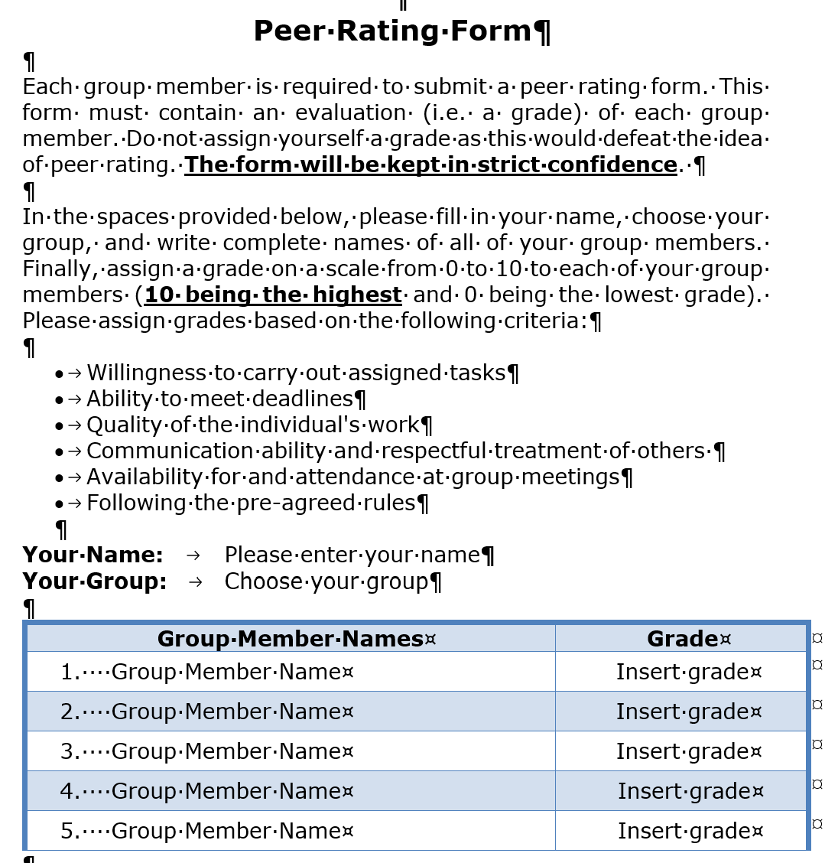
Peer Rating

Slide 16
Group Report
Groups of 4-5 students
Submission files:
  Quarto file
  Rendered output file (html recommended
  Data file
Online Consulting Hours (Registration needed)
Submission by Dec 15th, 6pm

Slide 17
Q & A
Any Questions?

